Slide 1
INTERNSHIP STUDIO
ETHICAL HACKING INTERNSHIP
TASK -2
DILIS DENNY

Slide 2
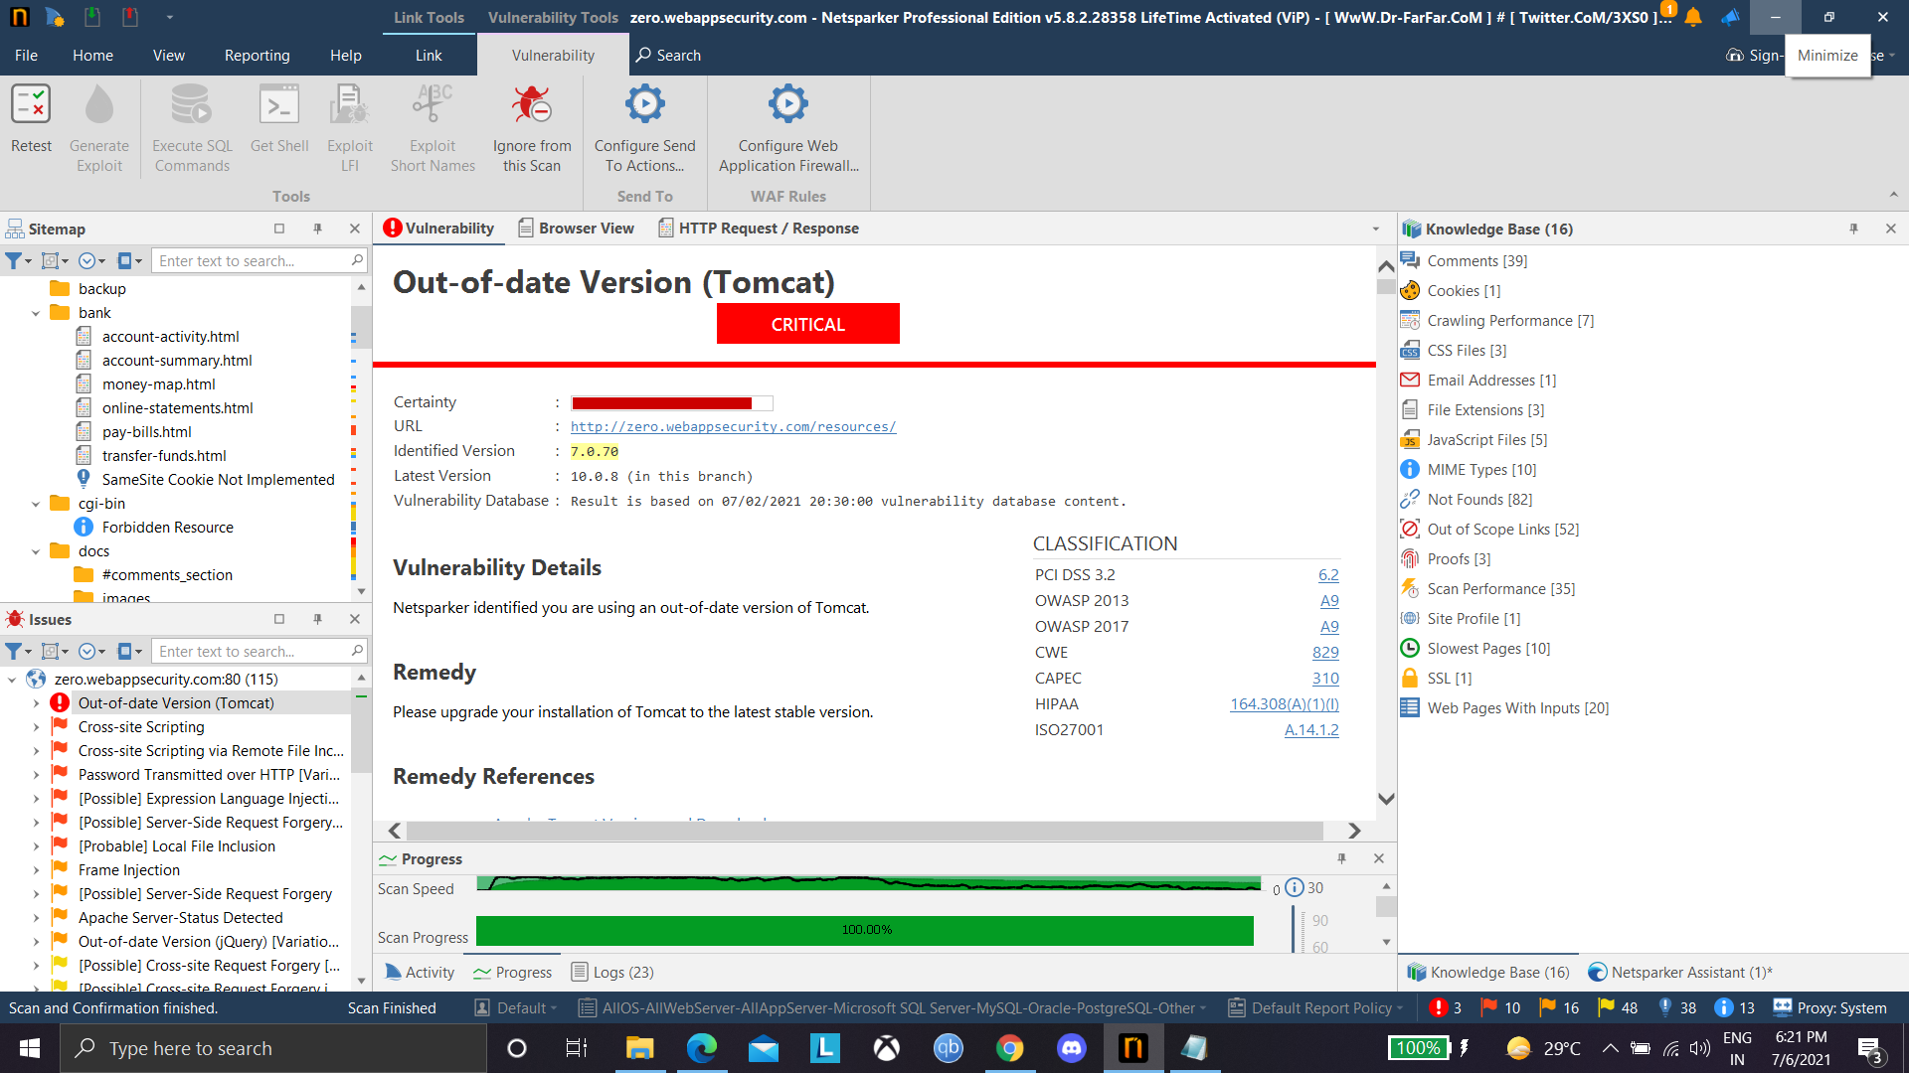
Automatic vulnerability Scanner (NETSPARKER)

Slide 3
MY REPORT
Domain >>
http://zero.webappsecurity.com
SubDomain>>
http://zero.webappsecurity.com/resources/
__
Testing Environment>>
Windows 10 Netspark_Professional_Edition_5.8.2.28358(Automatic vulnerability scanner)
__
Description>>
Out of Date verison of Tomcat found which will impact to our web application badly.

Slide 4
__
Steps to Reproduce>>
Step1:Using Netsparker version 5, enter the target link(http://zero.webappsecurity.com ) .
Step2:Selecting the options asked and start scanning
Step3:After crawling &Attacking ,we get the vulnerbilities
Step4:In the subdomain resources there is a critical vulnerability which is out of date version of Tomcat
__
Vulnerability in detail>>
Netspark V5 identified that our website is using out of date version of Tomcat(7.0.70 )
__
Impact>>
The impact of this issue is limited.The presence of a web application and the use of Java
can be detected even if it has been disabled . So, an attacker can determine the vulnerability of application and destroy's our server.
__
Solution>>
Upgrade our Apache Tomcat installation to at least version present in the market.
__

Slide 5
NETSPARK REPORT
Out-of-date Version (Tomcat)
CRITICAL
Certainty :
URL :http://zero.webappsecurity.com/resources/
Identified Version :7.0.70
Latest Version :10.0.8 (in this branch)
Vulnerability Database :Result is based on 07/02/2021 20:30:00 vulnerability database content.
CLASSIFICATION
PCI DSS 3.26.2
OWASP 2013A9
OWASP 2017A9
CWE829
CAPEC310
HIPAA164.308(A)(1)(I)
ISO27001A.14.1.2
Vulnerability Details
Netsparker identified you are using an out-of-date version of Tomcat.
Remedy
Please upgrade your installation of Tomcat to the latest stable version.
Remedy References
Apache Tomcat Versions and Download

Slide 6
Known Vulnerabilities in this Version:
*Apache Tomcat Deserialization of Untrusted Data Vulnerability
The fix for CVE-2020-9484 was incomplete. When using Apache Tomcat 10.0.0-M1 to 10.0.0, 9.0.0.M1 to 9.0.41, 8.5.0 to 8.5.61 or 7.0.0. to 7.0.107 with a configuration edge case that was highly unlikely to be used, the Tomcat instance was still vulnerable to CVE-2020-9494. Note that both the previously published prerequisites for CVE-2020-9484 and the previously published mitigations for CVE-2020-9484 also apply to this issue.
Affected Versions
7.0.0 to 7.0.107
External References
CVE-2021-25329
*Apache Tomcat Insufficient Information Vulnerability
Apache Tomcat through 7.0.x allows remote attackers to cause a denial of service (daemon outage) via partial HTTP requests, as demonstrated by Slowloris.
Affected Versions
7.0.0 to 7.0.100
External References
CVE-2012-5568

